Slide 1
Rating prediction PROJECT
BY – KHUSHBOO GUPTA

Slide 2
Problem Statement
We have a client who has a website where people write different reviews for technical products. Now they are adding a new feature to their website i.e. The reviewer will have to add stars(rating) as well with the review. The rating is out 5 stars and it only has 5 options available 1 star, 2 stars, 3 stars, 4 stars, 5 stars. Now they want to predict ratings for the reviews which were written in the past and they don’t have a rating. So, we have to build an application which can predict the rating by seeing the review.
Data Collection Phase: You have to scrape at least 20000 rows of data. You can scrape more data as well, it’s up to you. more the data better the model, In this section you need to scrape the reviews of different laptops, Phones, Headphones, smart watches, Professional Cameras, Printers, Monitors, Home theater, Router from different e-commerce websites. Basically, we need these columns-
_{1) reviews of the product.}
_{2) rating of the product.}
Model Building Phase: After collecting the data, you need to build a machine learning model. Before model building do all data preprocessing steps involving NLP. Try different models with different hyper parameters and select the best model. Follow the complete life cycle of data science. Include all the steps like-
_{1. Data Cleaning}
_{2. Exploratory Data Analysis}
_{3. Data Preprocessing}
_{4. Model Building}
_{5. Model Evaluation}
_{6. Selecting the best model}

Slide 3
Our Exercise
Scrape the rating and reviews of different products of different category from an online e-commerce website. Do the data cleaning and data preprocessing. Build a model which can be used to predict the rating of the reviews in terms of 5,4,3,2,1. Here 5 means the review about the product is very good and customer likes it where 1 means it is something worst review and customer is upset from it.

Slide 4
Data collection phase
Using the selenium we can scrap the data from an e-commerce website like amazon, flipkart. With the help of selenium we can scrap the data easily. We are scraping the information such as whole review of a customer, their rating, how many helpfuls are there and the title of the review. After scrapping the data successfully make a DataFrame of that & save it as csv file for future use.

Slide 5
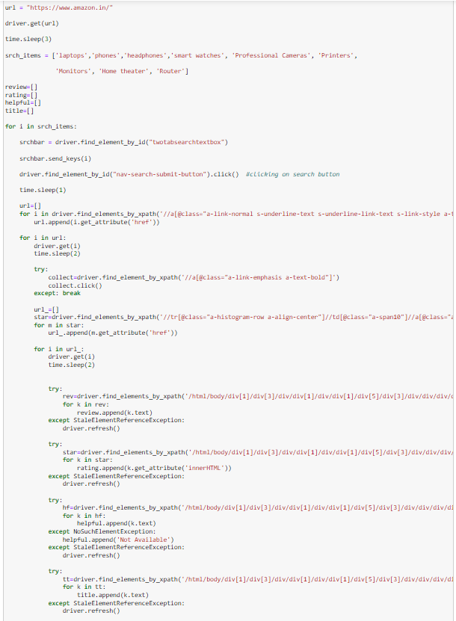
Let’s see the code for Data Scraping
Import selenium and webdriver to initiate the chrome.
Get the website using driver.get
Create blank list for the attributes you want to collect
Execute the code for scraping the data of each attribute using correct xpath and excepting handling
Make a DataFrame of extracted data and store it in a csv file

Slide 6
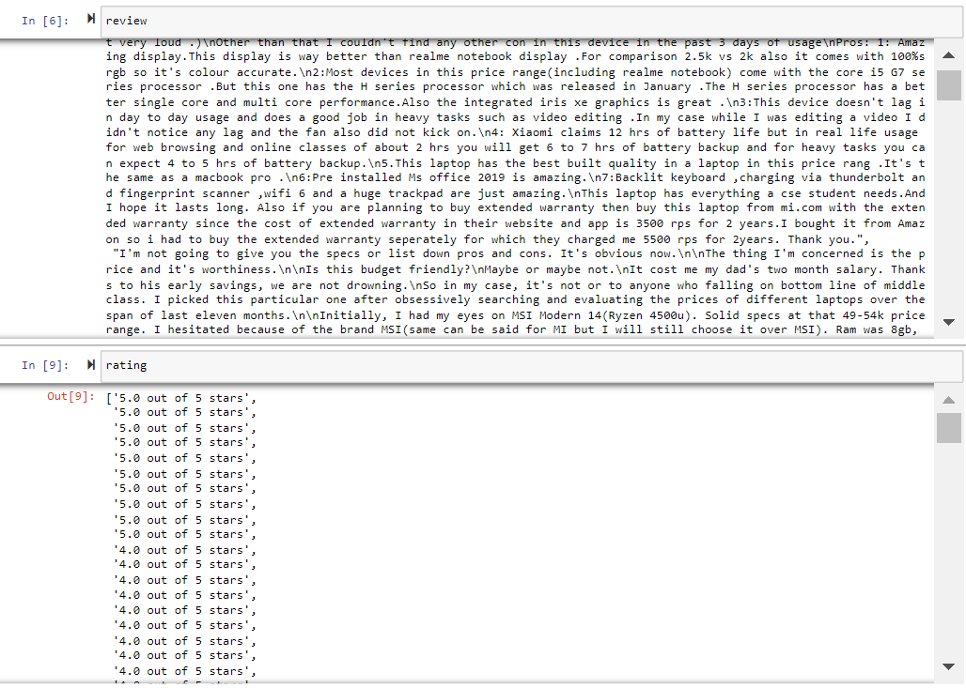
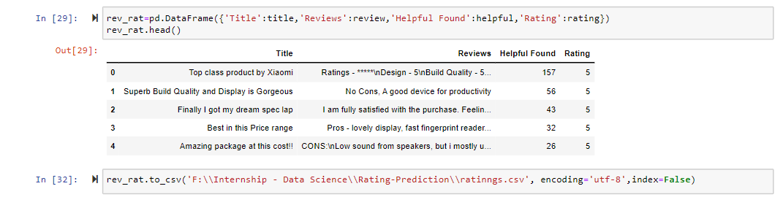
Let’s see the code for Data Scraping

Slide 7
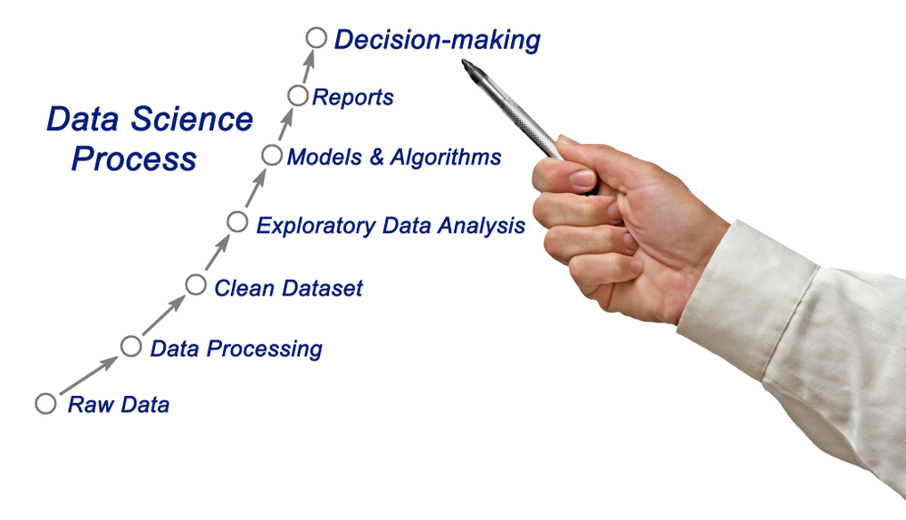

Slide 8
Model building phase
Now, we have successfully scrap the data of around 3328 rows.
Let’s go ahead with the data cleaning and EDA process. As we have the classified data in target we will go with the classification models to predict the rating. Use the different classification algorithms to find the best model for our prediction. Use the CV score and different hyper parameters to find the best model. Save the best model and check the actual & predicted values from your best model.

Slide 9
Steps Involved
Load the dataset
Distinguish the attributes
Checking the null values & handled them accordingly
Do the EDA
Check the correlation & removing the outliers
Feature Engineering – Find the best machine learning model to get the best accuracy.
Check the cross val score & perform the hypermeter tuning.
Save the model & check the predicted & actual values using the best saved model.

Slide 10
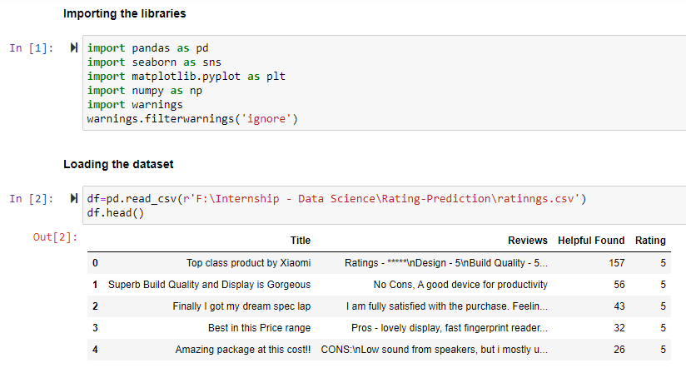
Load the dataset

Slide 11
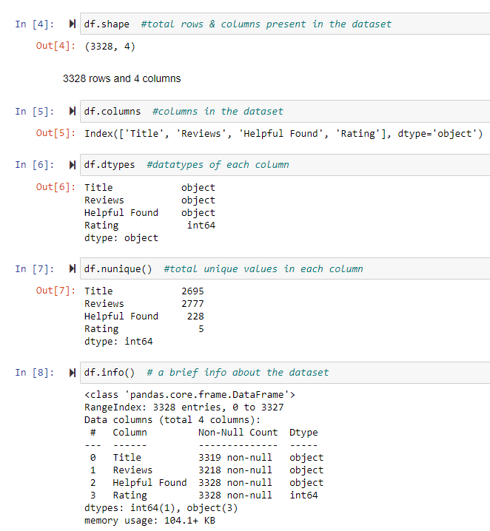
Checking the Attributes
First & last five rows the dataset
Shape of the dataset
Columns present in the dataset
Brief info about the dataset
Datatype of each column
Null values present in the dataset
Number of unique values present in each column

Slide 12
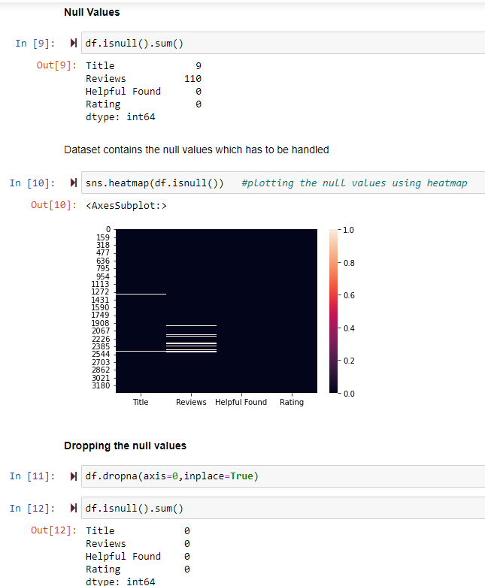
Null Values
Our dataset contains null value in the columns having text. Also there is no too much rows so we can drop the rows containing the null values and get a null free datatset.

Slide 13
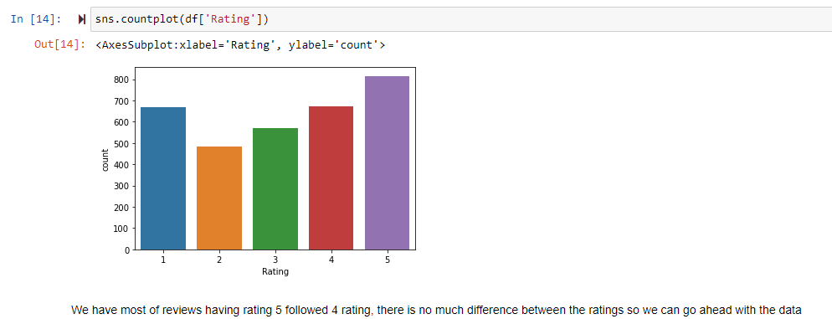
EDA
Using the countplot we are trying to understand the balancing between each class in target variable. As there is not too difference between the probability we can use this data for our model learning, no need to balance the data.

Slide 14
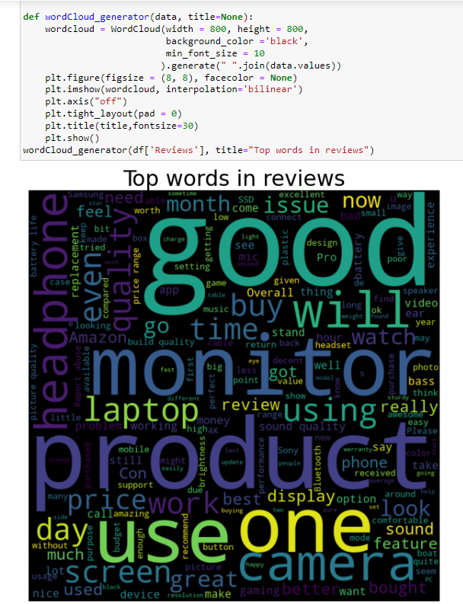
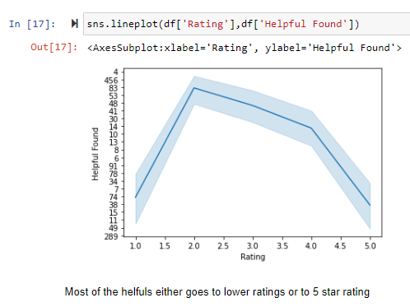
EDA

Slide 15
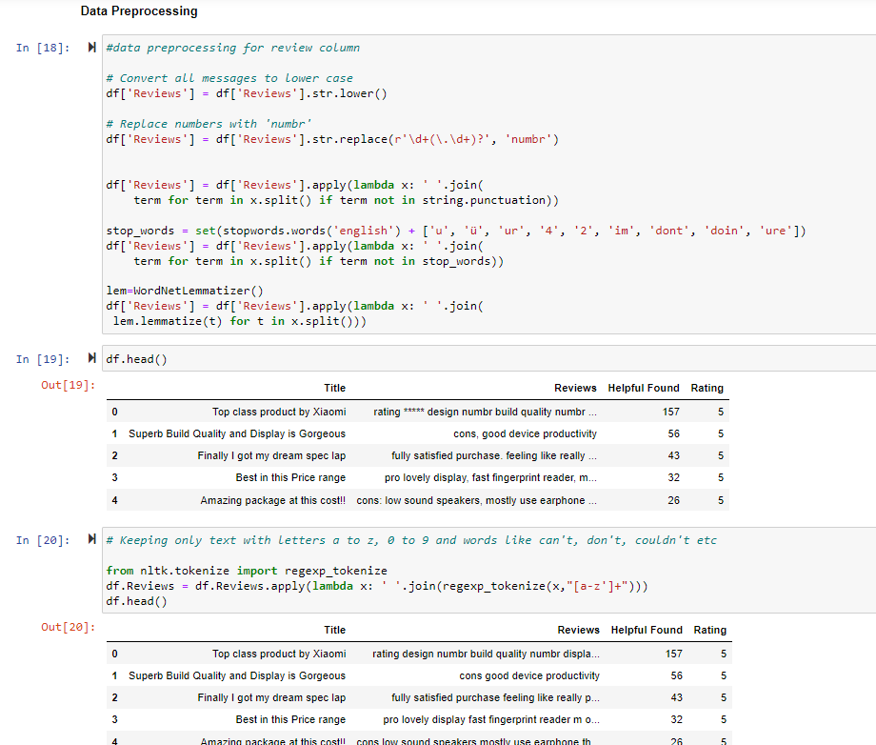
After Doing the EDA, let’s do the next step
Do the data pre-processing i.e. cleaning the reviews and title columns as they contain non-relevant words and symbols. Tokenize each column for further processing.
Afterwards, using the describe function we will elaborate the statistical summary of the dataset which contains the count, min, max, standard deviation, mean etc. of every column.
Find the correlation between each column
Plotting the outliers using boxplot
Checking the skewness.

Slide 16
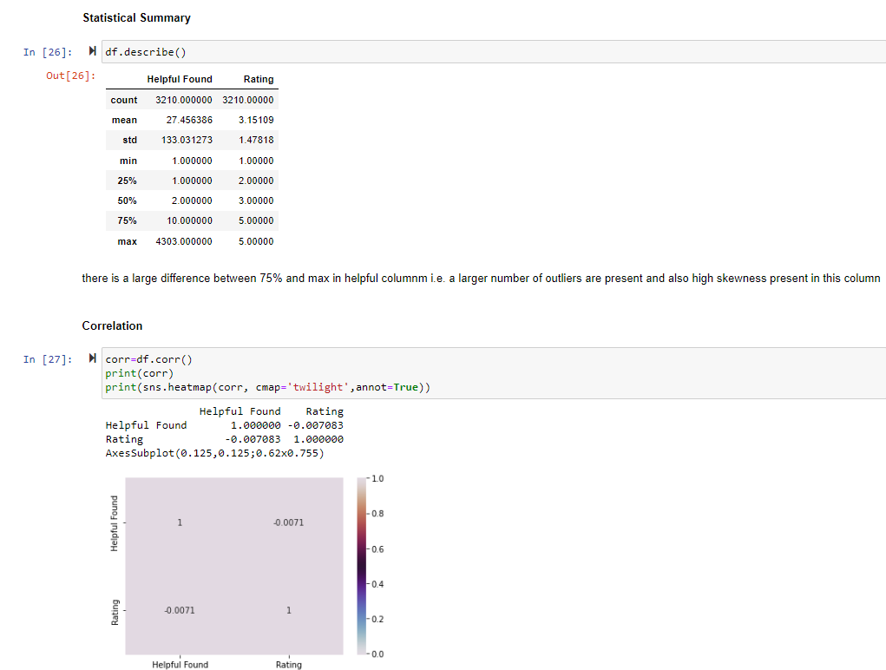
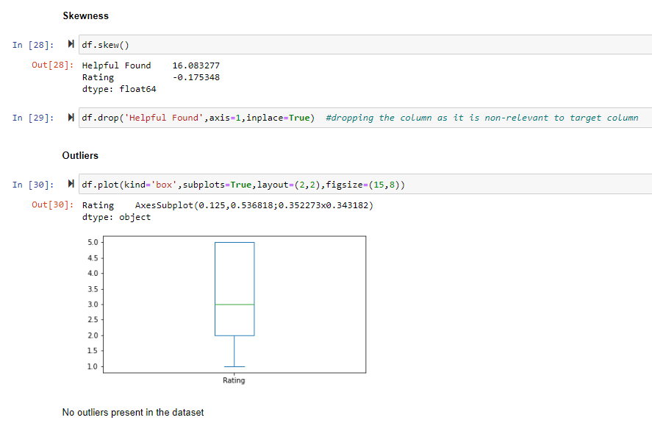
STATISTICAL SUMMARY, CORRELATION, OUTLIERS

Slide 17


Slide 18
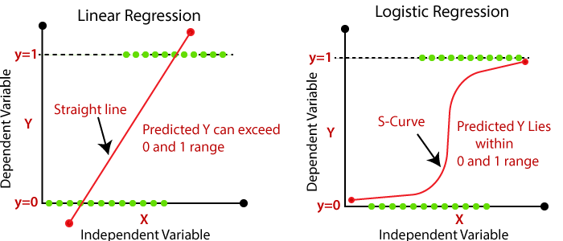
Is this a Regression problem or Classification problem?
By looking at the output i.e. target variables, this is a binary output either 1 or 0 not a continuous output so we go for the classification machine learning algorithms to predict the defaulter.
What does Classification mean?
Classification is the process of finding or discovering a model or function which helps in separating the data into multiple categorical classes i.e. discrete values. In classification, data is categorized under different labels according to some parameters given in input and then the labels are predicted for the data.

Slide 19
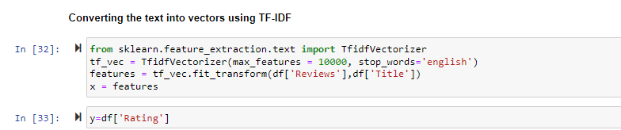
Vectorization
As the model does not understand the text, it understands only numbers, so we have to convert the text in vectors such that model can lean them and predict the target variable. Using the TF-IDF word embedding, we successfully convert the text into vectors.

Slide 20
Used Classification Algorithms
Logistic Regression
from sklearn.linear_model import LogisticRegression
Decision Tree Classifier
from sklearn.tree import DecisionTreeClassifier
KNN Classifier
from sklearn.neighbors import KNeighborsClassifier
Random Forest Classifier
from sklearn.ensemble import RandomForestClassifier
Multinomial NB
from sklearn.naive_bayes import MultinomialNB
AdaBoost Classifier
from sklearn.ensemble import AdaBoostClassifier
GradientBoosting Classifier
from sklearn.ensemble import GradientBoostingClassifier
MODEL | ACCURACY
Logistic Regression | 0.3541017653167186
Decision Tree Classifier | 0.32502596053997923
Random Forest Classifier | 0.3509865005192108
KNN Classifier | 0.31671858774662515
Multinomial NB | 0.2824506749740395
Adaboost Classifier | 0.3333333333333333
GradientBoost Classifer | 0.3426791277258567

Slide 21
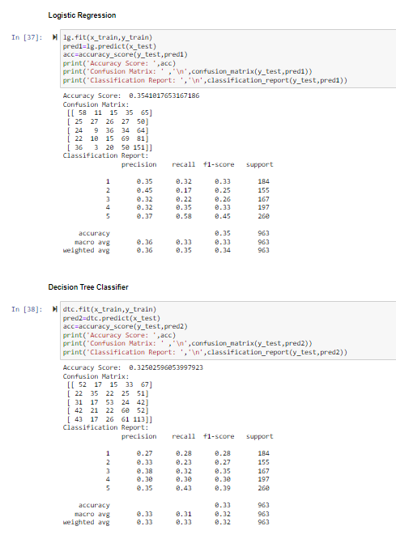
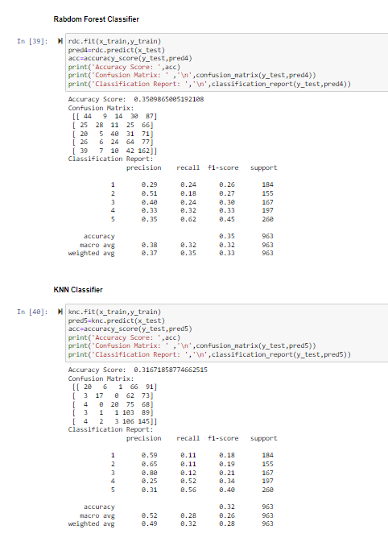
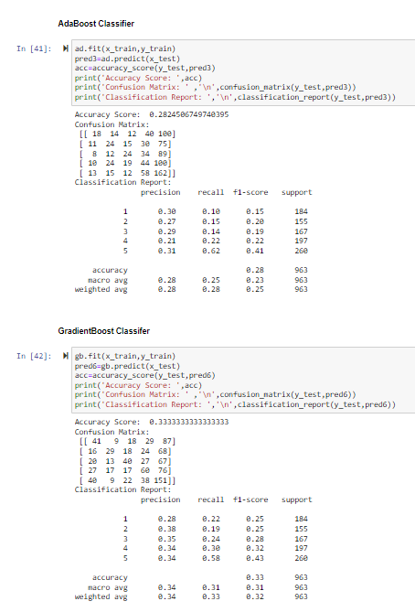

Slide 22
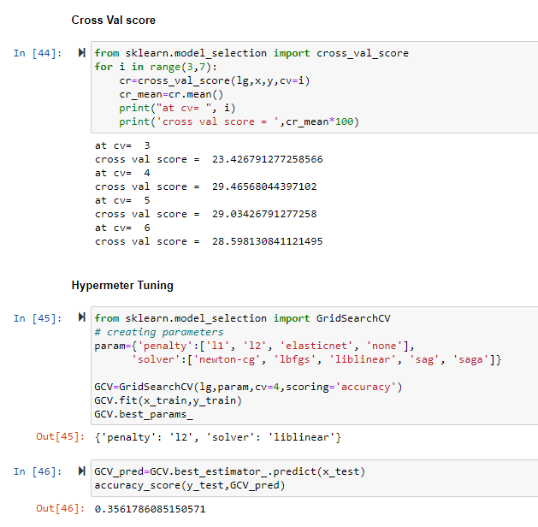
Cross Val Score & Hypermeter Tuning
Finding the cv at which the model runs the best.
Finding the parameters of the model whose accuracy we found the best at which it runs the best using the hypermeter tuning.

Slide 23
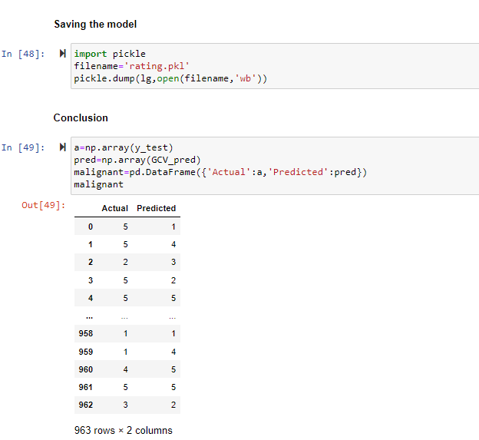
Saving the Model
After doing all the EDA process and find our best regression algorithm we will save that model for future predictions using the pickle algorithm.
We will conclude after comparing the actual & predicted values.

Slide 24


